Slide 1

Paim0n: your Genshin Impact Chatbot
Team 6 - TaiGen
Jonathan Lin
Han Hung, Chen
Chia Hsin, Wang
YenPing, Chang
Coach - Tanmay Patil
Notes:
Hello everyone, today we’re excited to present Paim0n, our AI chatbot designed to help players navigate Genshin Impact. We are Team 6 - TaiGen, consisting of Jonathan Lin, Han Hung Chen, Chia Hsin Wang, and YenPing Chang, with guidance from our coach, Tanmay Patil.

Slide 2

Problem & solution
Notes:
Genshin Impact is a complex game with a vast world map, intricate character builds, and an abundance of weapons and items. Many players struggle to find quick, reliable answers to their in-game questions, which combined with the seemingly infinite avenues of game play, creates a steep learning curve for beginner players.
Our proposed solution is Paim0n, an AI chatbot that provides instant responses and in-depth game information, helping players optimize their experience efficiently.

Slide 3
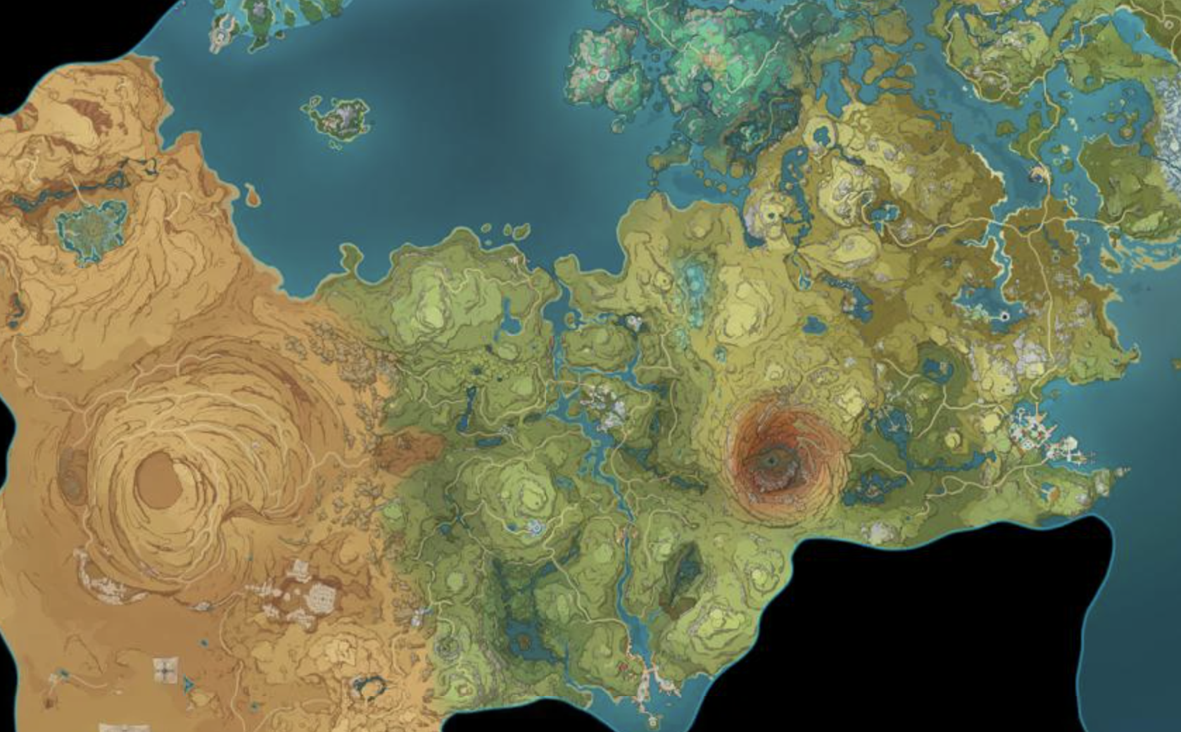
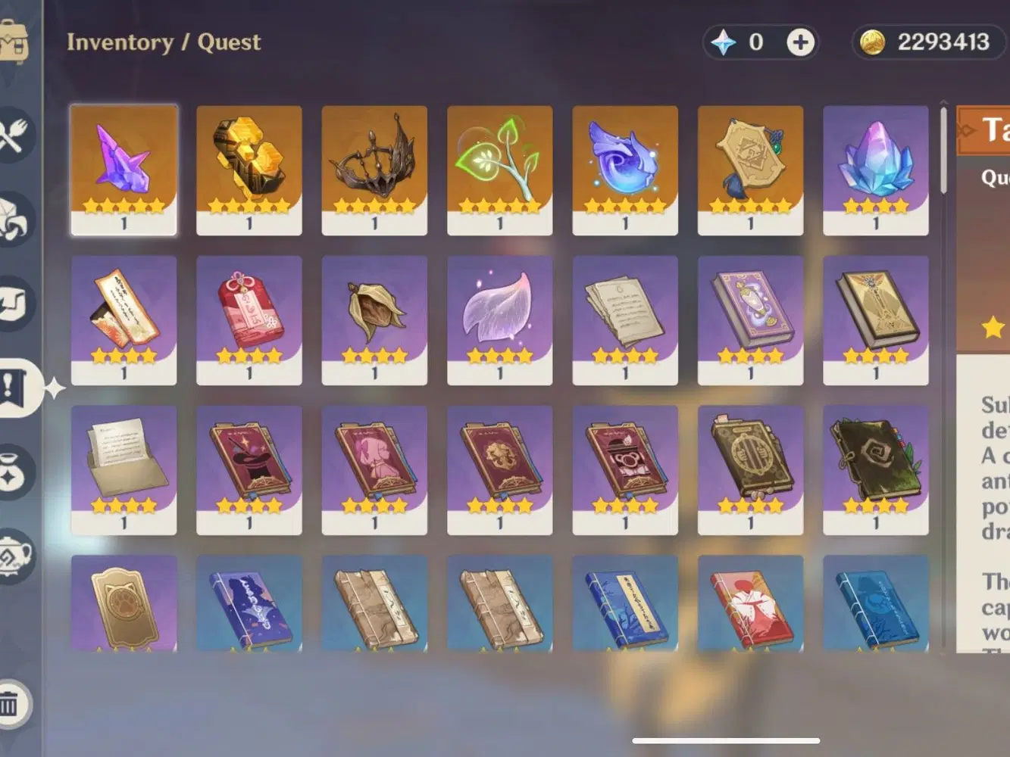
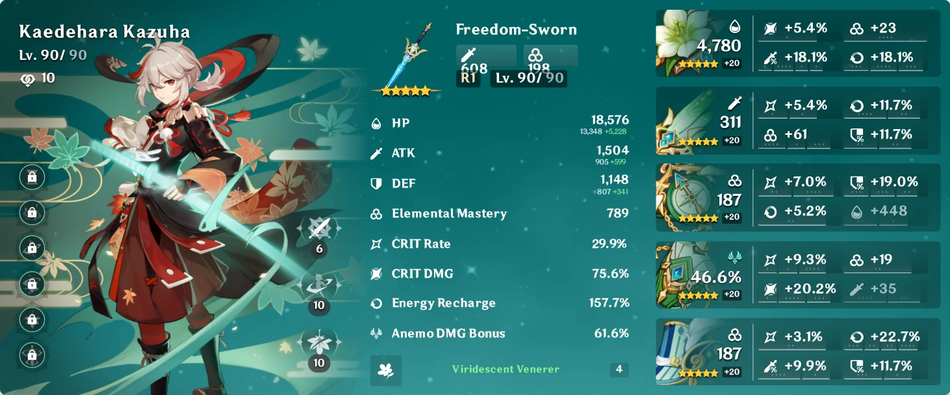


The Challenge: Game Complexity
Vast World map
Abundance of Items
Character builds
Proposal: AI Chatbot
1
Instant Answers
2
Detailed Information
Get answers to your questions. Paim0n provides quick support.
Access comprehensive game details. Learn about characters, weapons, bosses, wishing, map information, and more.

Slide 4
AI ChatBot Features
Notes:
Next, let’s talk about our chatbot’s features.

Slide 5



RAG
Database
Dataset
Character
Embedding
Retrieving
Weapon
Genshin Impact Data
Generating
Notes:
Retrieval-Augmented Generation (RAG) enhances a generative LLM's knowledge by supplying task-relevant data from an external source.You can imagine that the data source is the textbook for LLM.
We use RAG in our project through three main phases:
Indexing: We embed the Genshin Impact dataset. Table-formatted data is reformatted into text before embedding. The texts are chunked and transformed into vectors, which are stored in fast retrieval data structures. The database stays up-to-date as it can be manually updated anytime.
Retrieval: When users ask questions, the system uses a retrieval algorithm to find the most relevant information from the knowledge base.
Generation: The LLM generates smooth answers based on the retrieved information.

Slide 6


Tavily Search
Tavily is a search engine optimized for LLMs.
Tavily focuses on optimizing search for AI developers and AI agents.
Aimed at searching, scraping, filtering and extracting the most relevant information from online sources.
Tavily Search
Ask Question
Answer Question
Notes:
Tavily Search is a search engine.
It will search online source and filter the most relevant information by AI
When user ask a question, our program will utilize Tavily Search to enhance search online efficiency and accuracy.
Give the search result to LLM to generate answers.

Slide 7
Structure
Embedding
RAG
Ask / Answer
Questions
Tavily Search
Notes:
Overall, we embed data set to enhance ai chatbot’s ability to answer the basic question such as skill of certain character or a list of weapon ability.
In addition to that, ai chatbot will get online information from tavily search, make response more abundant.

Slide 8
Live Demo
Example use cases
Notes:
Now, let's see Paim0n in action! Some example queries include:
“Where can I farm bamboo?”
“Where is the best fishing spot?”
“How does the resin system work?” These real-use cases demonstrate how Paim0n makes gameplay more enjoyable and accessible.

Slide 9
Example questions:
Where can I farm the best fish?
How does the resin system work?
What is a recommended build for Amber?
When do Furina and traveler talk about Macaroni?

Slide 10
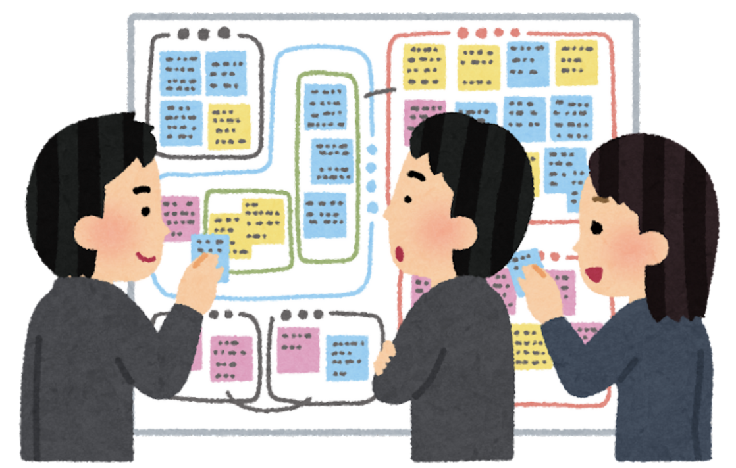
Evaluation
Utilizing Gemini to identify the top 10 most frequently asked questions by Genshin Impact players.
1. Evaluation Method
(1) BLEU Score (Bilingual Evaluation Understudy)
Purpose: Measures the similarity between AI-generated responses and reference answers, primarily used in machine translation and summarization evaluations.
Calculation: Compares n-gram (sequential word segments) matches between AI-generated responses and reference answers, applying smoothing techniques for better handling of short texts.
Score Range: 0 to 1, where a score closer to 1 indicates higher similarity between AI responses and reference answers.
(2) ROUGE Score (Recall-Oriented Understudy for Gisting Evaluation)
Purpose: Evaluates recall in AI-generated responses, commonly used in text summarization and generation tasks.
Evaluation Metrics:
ROUGE-1: Measures unigram (single-word) overlap between AI responses and reference answers.
ROUGE-2: Measures bigram (two-word phrase) overlap between AI responses and reference answers.
ROUGE-L: Based on the Longest Common Subsequence (LCS), assessing the syntactic structure and fluency of AI responses.

Slide 11
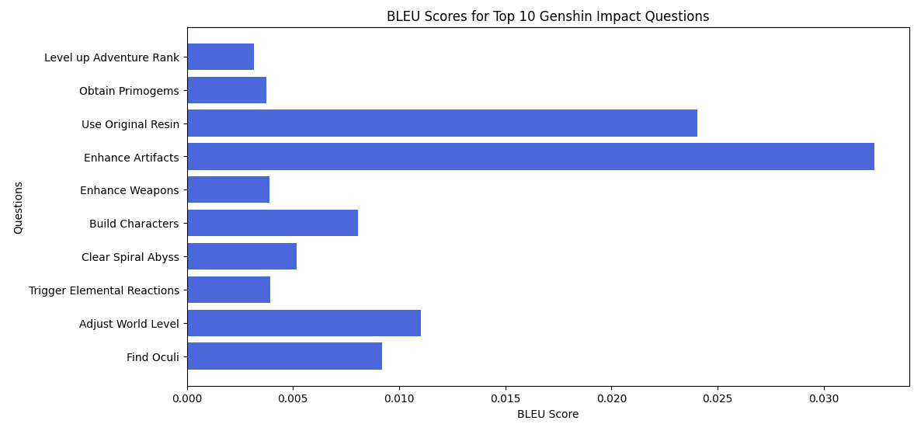
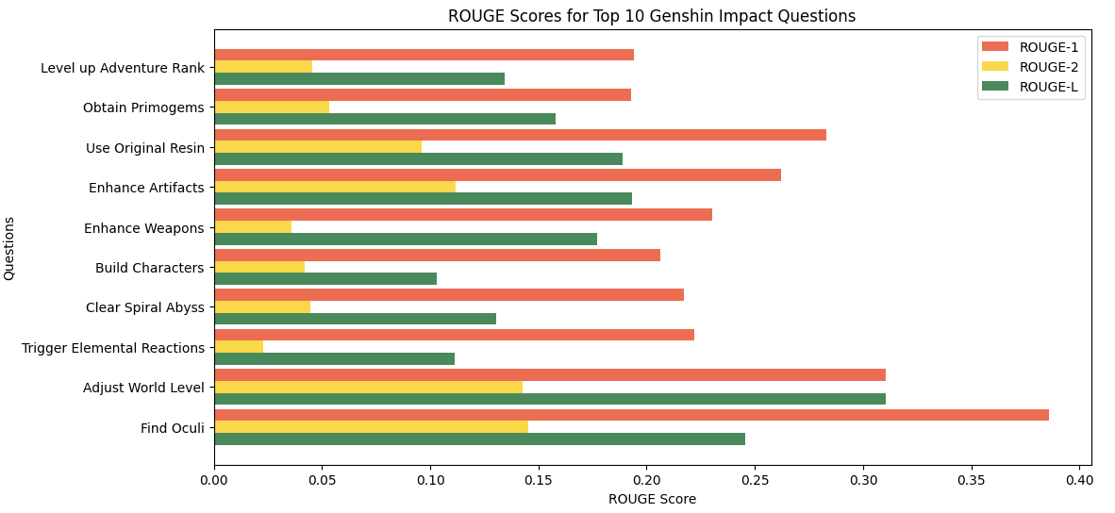
Evaluation
BLEU Score Analysis
Overall low scores (highest at 0.0324), indicating that AI responses have low lexical similarity to reference answers.
Highest BLEU Score: "How to choose and enhance Artifacts?" (BLEU: 0.0324).
Lowest BLEU Score: "How to level up Adventure Rank quickly?" (BLEU: 0.0032), suggesting significant wording differences between AI responses and reference answers.
Possible Cause: AI may paraphrase responses differently, failing to align precisely with reference wording and syntax.
ROUGE Score Analysis
ROUGE-1 scores are relatively high (0.2 ~ 0.38), meaning AI responses have good single-word matching with reference answers.
ROUGE-2 scores are generally low (mostly below 0.1), showing that AI struggles with accurate phrase-level matching, likely due to flexible phrasing.
ROUGE-L scores are relatively stable (0.1 ~ 0.31), indicating some structural similarity between AI responses and reference answers.

Slide 12

Conclusion
Low BLEU Scores → AI responses have low lexical similarity to reference answers, indicating possible excessive paraphrasing.
Higher ROUGE-1 & ROUGE-L Scores → AI responses show good single-word and structural similarity, but weak phrase-level matching (ROUGE-2).
AI struggles with technical explanations and structured responses, especially for complex questions, affecting accuracy.
Suggested Improvements:
Enhance phrase-level matching (Improve ROUGE-2)
Reduce excessive paraphrasing (Increase BLEU scores)
Incorporate domain-specific data (Improve AI response accuracy)
➡ AI needs to refine word alignment and expression to improve response accuracy and readability.

Slide 13
Any Questions?

